Slide 1


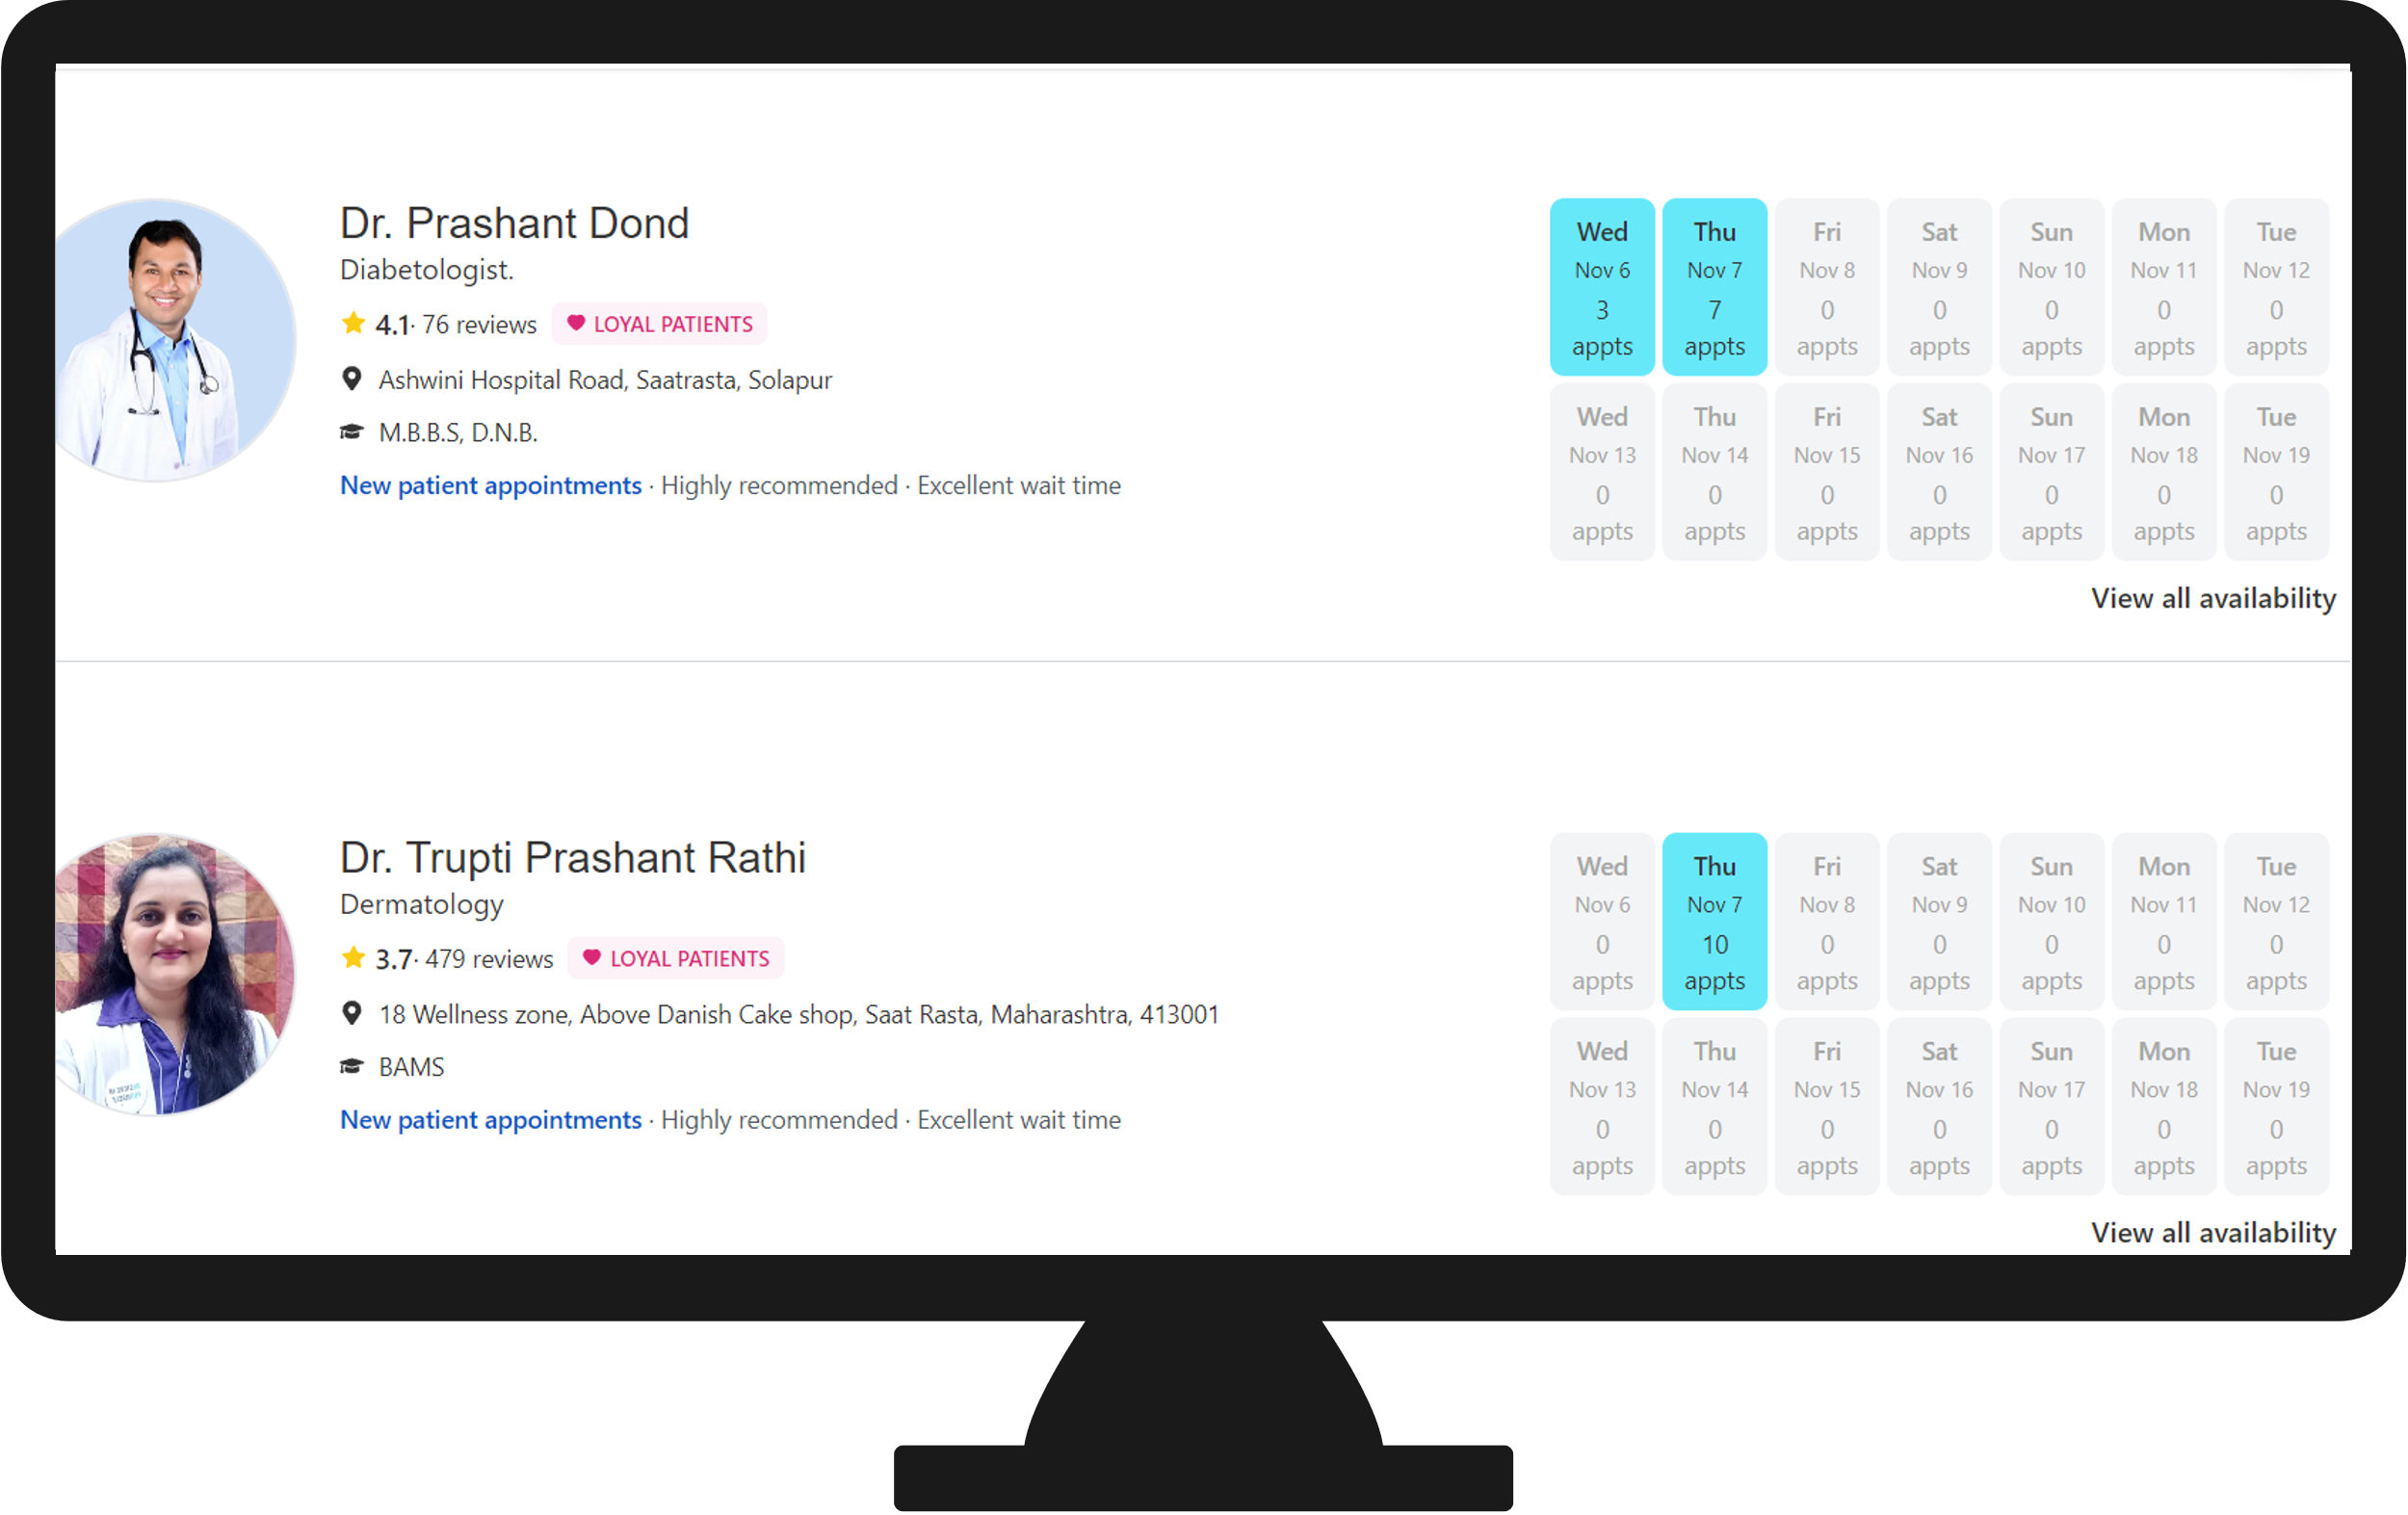
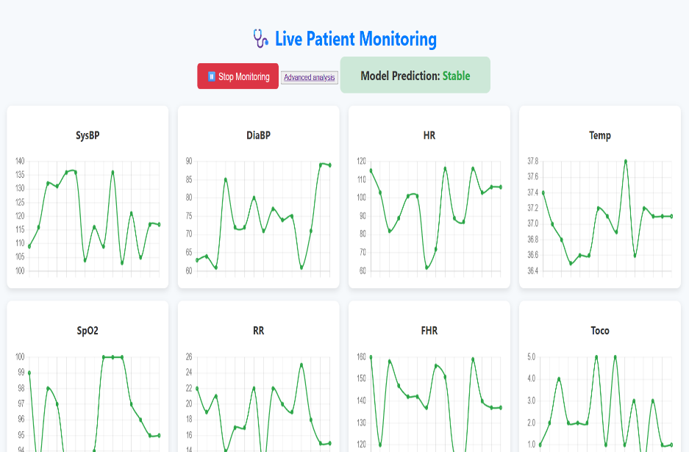
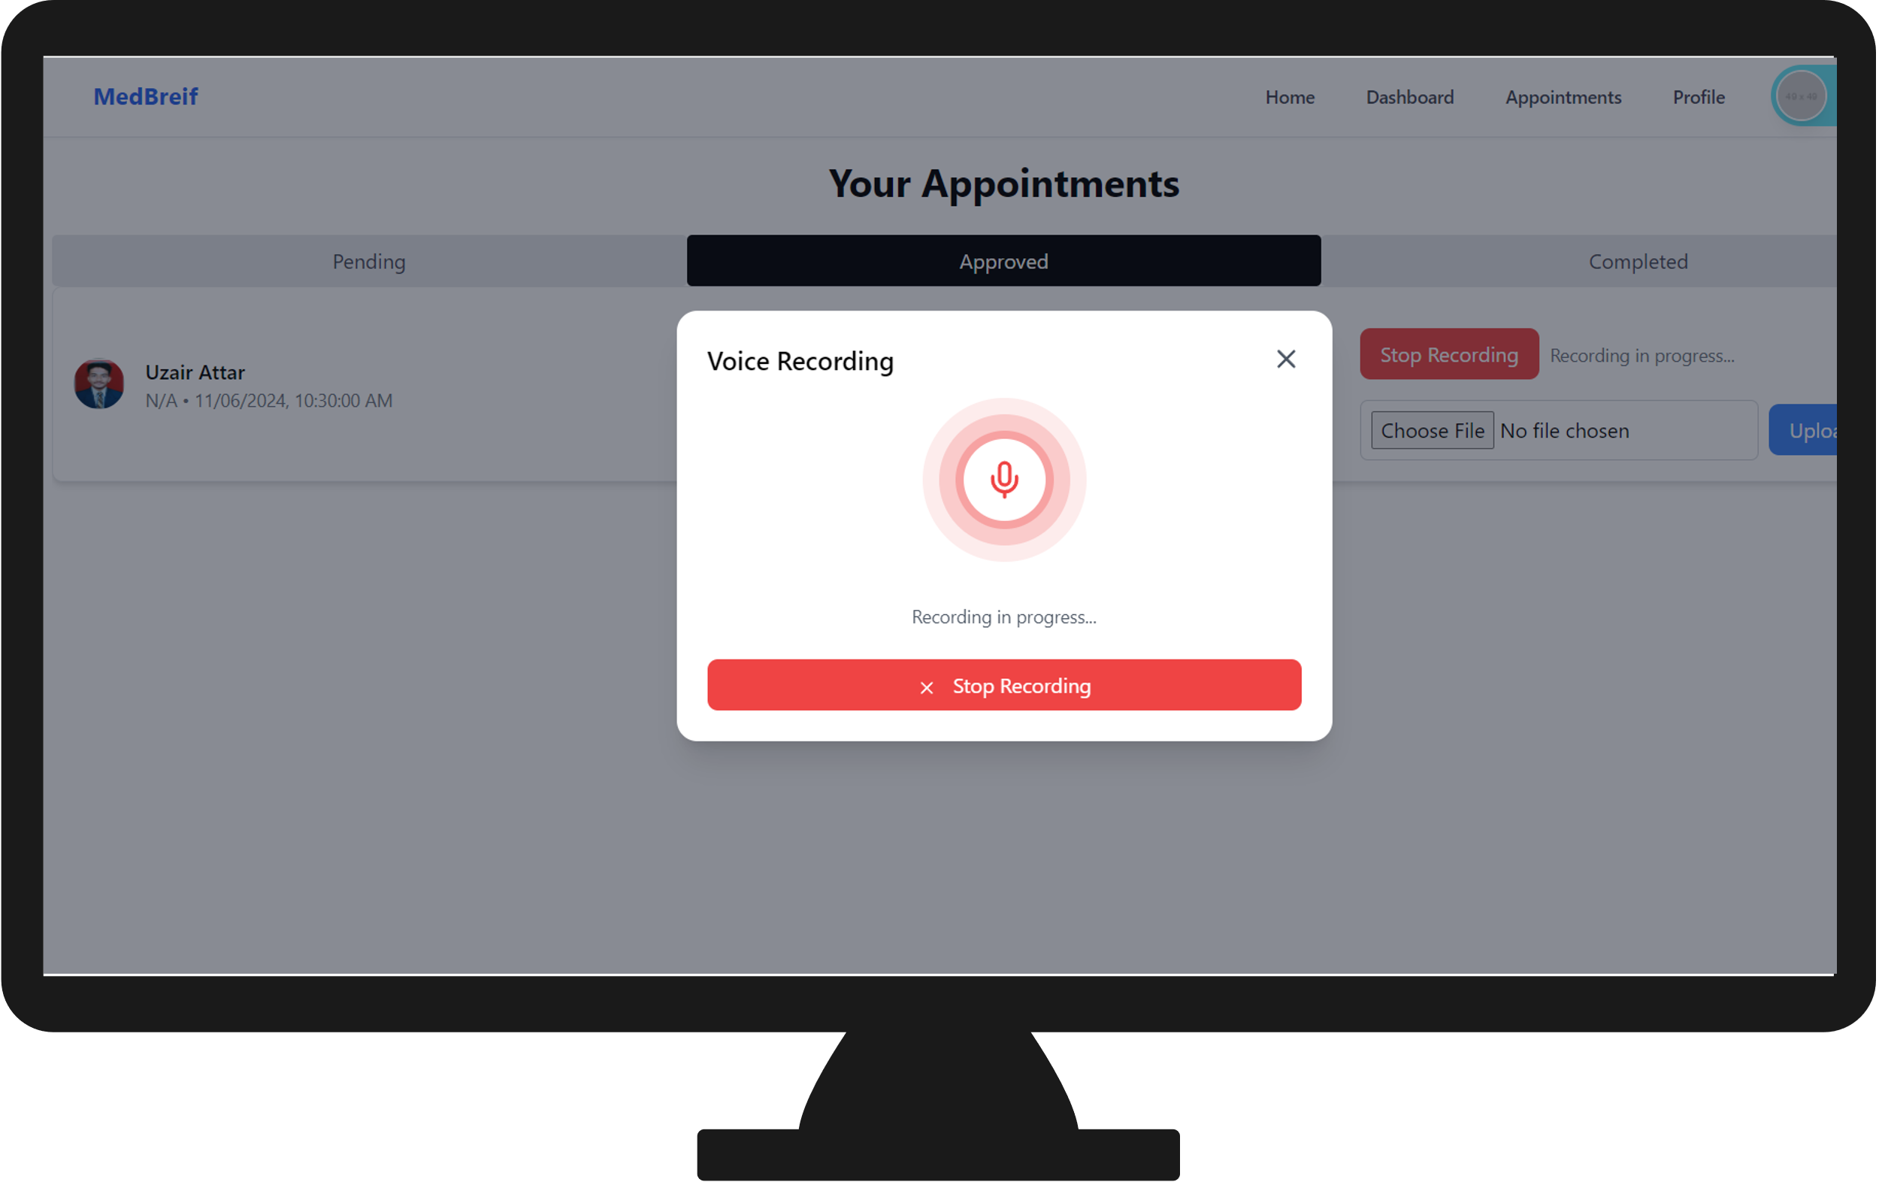
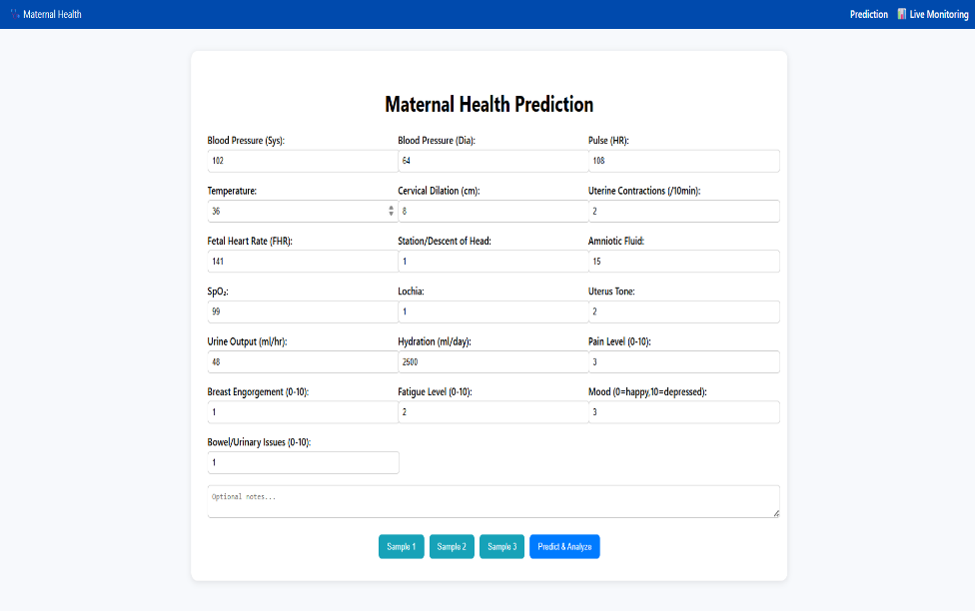
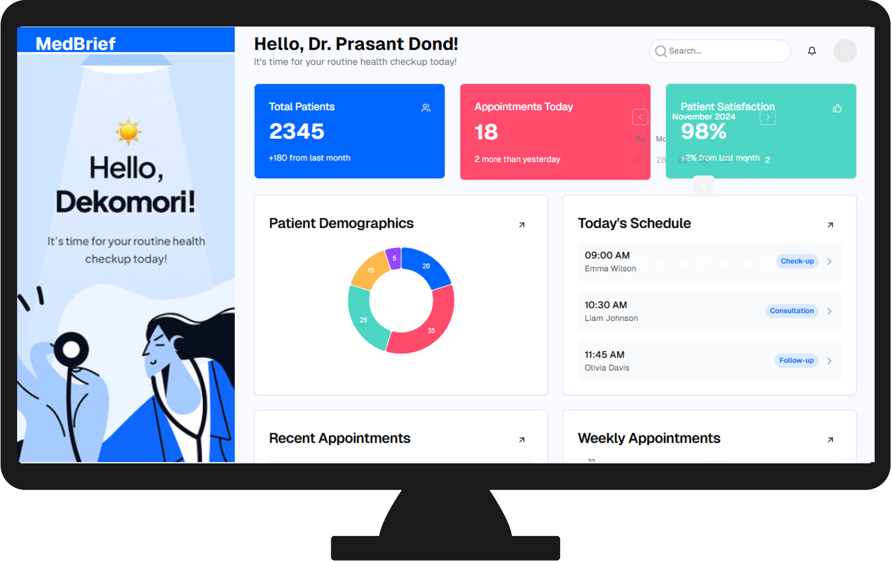
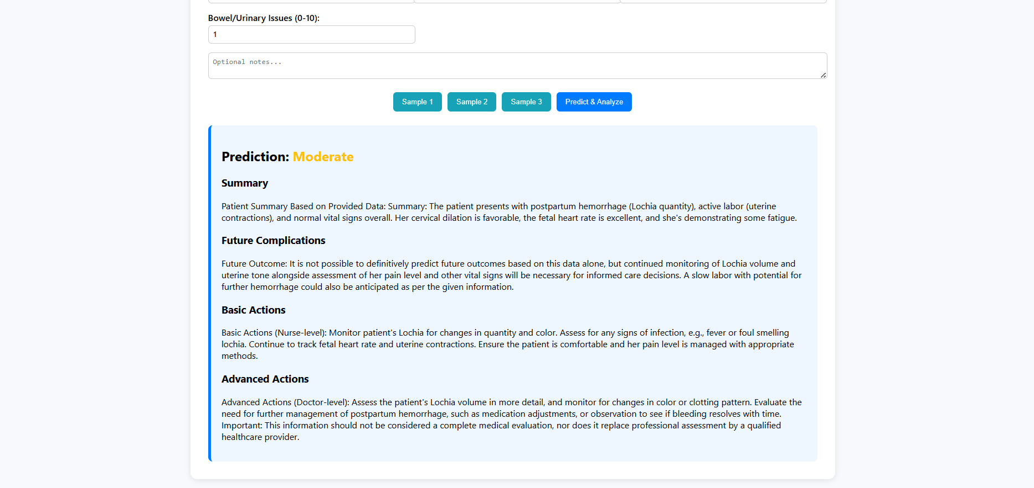
Department of Artificial Intelligence and Data Science
MatriCare AI: AI-Based Prediction of Labor-Related Complications
Introduction or Abstract
Methodlogy
Result
Conclusion
MatriCare AI is an AI-driven healthcare solution designed to predict labor-related complications in expectant mothers. By analyzing medical history, pregnancy data, and relevant health parameters, the system helps doctors and healthcare providers identify potential risks early. This enables timely interventions, reduces maternal and fetal complications, and supports safer, more informed decision-making during pregnancy.
Data Collection: Gather pregnancy-related medical data and store in CSV files.
Data Preprocessing: Clean data, handle missing values, and normalize features. (Technology: Python, Pandas, NumPy)
Feature Selection: Identify key parameters affecting labor complications. (Technology: Python, Scikit-learn)
Model Development: Train predictive models using machine learning algorithms like Random Forest. (Technology: Python, Scikit-learn, Random Forest)
Model Evaluation: Test model performance using metrics like accuracy, precision, recall, and F1-score. (Technology: Python, Scikit-learn)
Prediction & Alert System: Connect the trained model with Flask to predict complications and notify doctors. (Technology: Python, Flask)
User Interface: Provide a simple web interface for healthcare providers to input patient data and view predictions. (Technology: HTML, CSS, JavaScript, Flask)
MatriCare AI is a cutting-edge healthcare solution designed to predict labor-related complications in expectant mothers. By analyzing critical medical and pregnancy-related data using advanced AI techniques, the system empowers healthcare providers to take timely and informed decisions. This helps reduce maternal and fetal risks, supports safer pregnancy management, enhances early intervention strategies, and contributes to better maternal and child healthcare outcomes. With continuous learning, MatriCare AI has the potential to transform prenatal care and make childbirth safer for mothers and babies alike.
Accuracy : 90+
Objective
The objective of MatriCare AI is to develop an intelligent system that predicts potential labor-related complications in pregnant women by analyzing medical and pregnancy-related data. This aims to assist healthcare providers in making timely, informed decisions, ultimately improving maternal and fetal safety and reducing the risk of complications during childbirth.
Project Team
Guide: - Prof. G. N. Chanderki
Sakshi Bhumkar (Roll 64)
Aditya Kamble (Roll 49)
Varsha Devdas (Roll 73)
Md Zaid Sutar (Roll 38)
A.Y. 2025-26

